Slide 1

DATA ANALYTICS
AIMAN ALAM

Slide 2
TABLE OF CONTENTS
DECISION TREES
How DT work?
HYPERPARAMETER TUNING
ENSEMBLE LEARNING
BAGGING
BOOSTING
ADVANTAGES OF ENSEMBLE LEARNING
RANDOM FOREST
ADVANTAGES OF RANDOM FOREST
ROC – AUC
ADABOOST
GRADIENT BOOSTING
LOGISTIC REGRESSION
VOTING CLASSIFIER

Slide 3
DECISION TREES
A decision tree is a supervised machine learning model that is used for both classification and regression tasks. It is a tree-like model where an internal node represents a feature or attribute, the branch represents a decision rule, and each leaf node represents the outcome or class label. The topmost node in a decision tree is called the root node.

Slide 4
HOW DT WORKS?
1. Root Node: The feature that best splits the data is selected as the root node.
2. Internal Nodes: Each internal node represents a decision based on a specific feature. The dataset is split into subsets based on the values of this feature. A decision node is a point where the tree makes a decision about how to split the data based on a certain feature. The decision node represents a condition or a question about a specific feature, and the tree branches out into different paths based on the possible outcomes of that decision.
3. Branches: Each branch represents an outcome of the decision, leading to the next internal node or a leaf node.
4. Leaf Nodes: Leaf nodes represent the final outcome or the class label. Each leaf node is associated with a specific class or a regression value.
The process of building a decision tree involves recursively splitting the dataset into subsets based on the selected features until a stopping criterion is met. This criterion could be a maximum depth for the tree, a minimum number of samples in a leaf node, or other conditions to prevent overfitting.

Slide 5
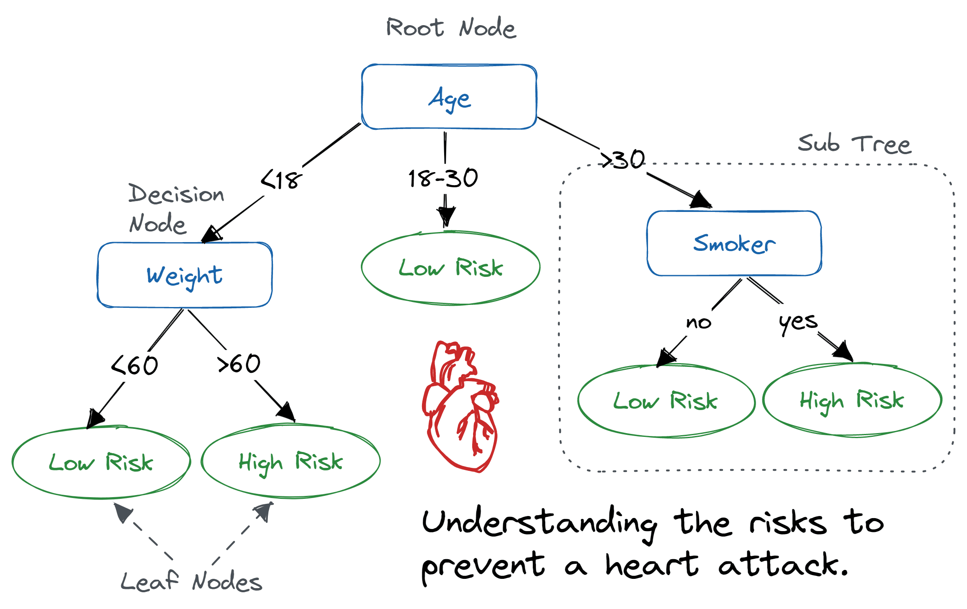
Internal node
or

Slide 6
HYPERPARAMETER TUNING
Hyperparameter tuning, also known as hyperparameter optimization, is the process of finding the best set of hyperparameters for a machine learning model. Hyperparameters are configuration settings external to the model itself and are not learned from the data during training. They are crucial parameters that control the overall behaviour of a machine learning algorithm, influencing aspects such as model complexity, training speed, and generalization performance.
Examples of hyperparameters include learning rates, regularization strengths, the number of hidden layers and nodes in a neural network, the depth of a decision tree, and many others. The optimal values for these hyperparameters depend on the specific dataset and the characteristics of the problem at hand.

Slide 7
Baking a Cake
Imagine you re trying to bake the perfect cake, and you have a recipe with some adjustable settings:
1. Ingredients (Features):
- The ingredients for your cake are like the features in a machine learning model. These are the elements that contribute to the final outcome.
2. Recipe Instructions (Model):
- Your recipe is like a machine learning model. It tells you how to combine and process the ingredients to get the desired result.
3. Baking Temperature and Time (Hyperparameters):
- Now, imagine you have two knobs on your oven—one for temperature and one for time. These knobs are like hyperparameters in a machine learning model.
- Temperature: This is how hot your oven gets, analogous to a hyperparameter like the learning rate or the depth of a decision tree.
- Time: This is how long you bake your cake, analogous to a hyperparameter like the number of trees in a Random Forest or the number of iterations in a boosting algorithm.
4. Perfecting the Cake (Hyperparameter Tuning):
- Initially, you set the temperature and time based on a rough estimate or default values.
- After baking a few cakes, you taste them and ask for feedback. You realize that adjusting the temperature or baking time might make the cake better.
- Hyperparameter tuning is like finding the best combination of temperature and time to make your cake perfectly moist and delicious.

Slide 8
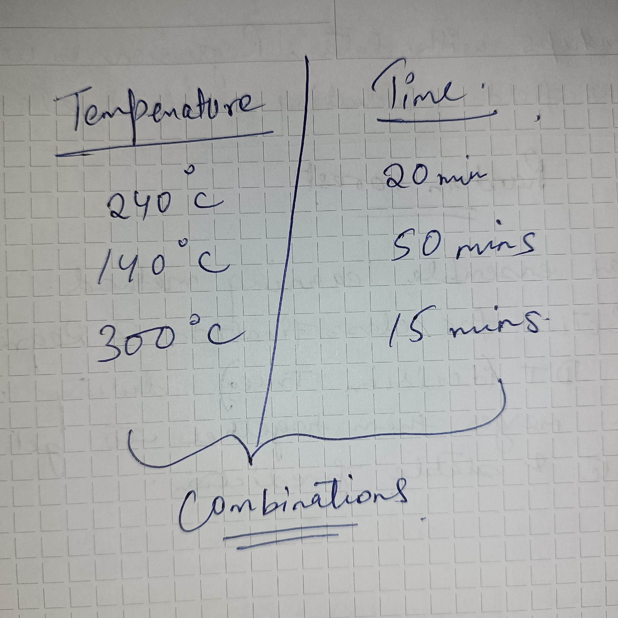
Grid Search:
Grid search is a method for systematically working through multiple combinations of hyperparameter values, training a model for each combination, and evaluating the model's performance using cross-validation.

Slide 9
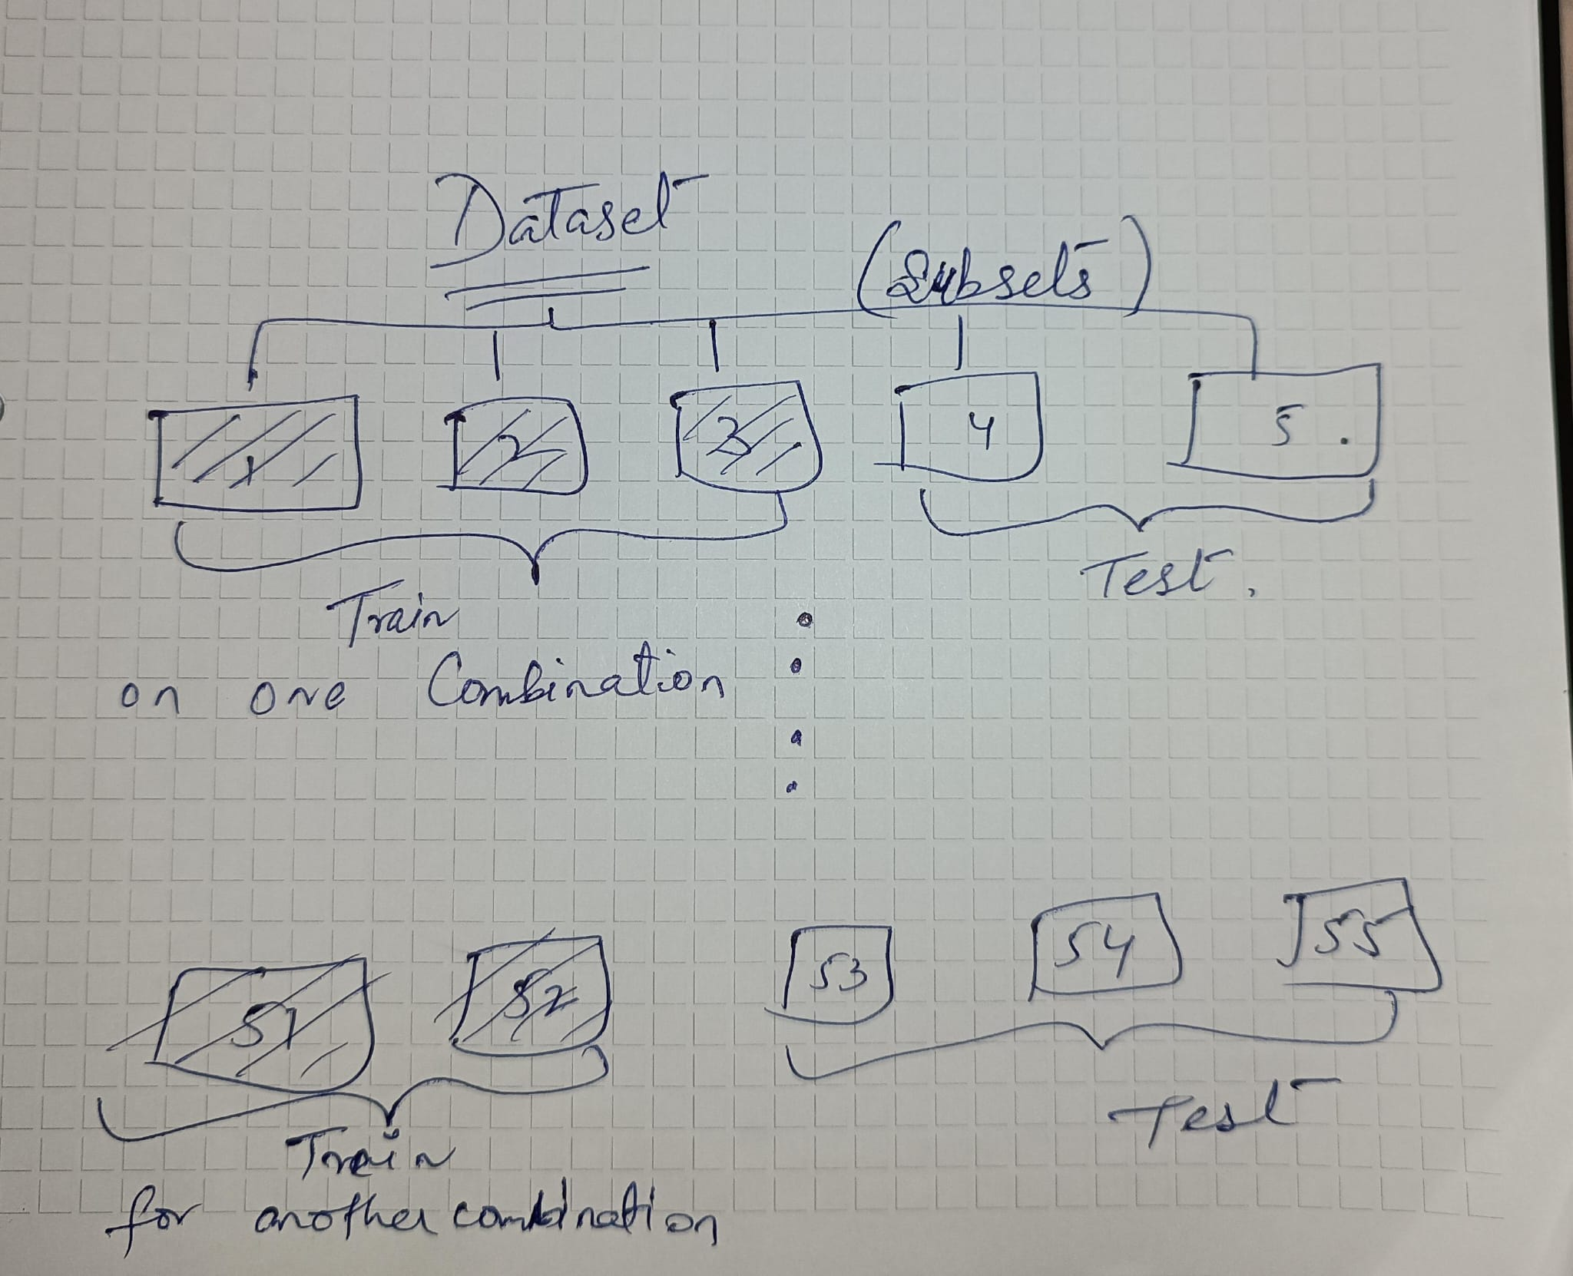
Cross-Validation:
Cross-validation is a technique for assessing the performance of a model by splitting the dataset into multiple subsets, training the model on some of these subsets, and evaluating it on the remaining subsets. This helps to get a more robust estimate of a model's performance.
GridSearchCV Function:
GridSearchCV automates the process of grid search and cross-validation. It takes a dictionary of hyperparameters and their possible values and performs an exhaustive search over all possible combinations.
It trains and evaluates a model for each combination using cross-validation and selects the combination that performs the best.

Slide 10
ENSEMBLE LEARNING
Ensemble learning is a machine learning technique that combines the predictions of multiple models (often called base learners or weak learners) to improve the overall performance and generalization of the system.
The idea behind ensemble learning is that by combining the strengths of different models, it s possible to compensate for the weaknesses of individual models and create a more robust and accurate predictive model.
Imagine you have a big decision to make, like predicting whether it will rain tomorrow. Now, you could ask different people for their opinions, each having their own way of predicting the weather. Some might look at the clouds, others might check the weather app, and some might even use a barometer.
Each person might make mistakes, but by combining all their predictions, you can get a more accurate overall prediction.
Ensemble learning is like that. Instead of relying on just one method to make predictions in a machine learning model, it combines the predictions of multiple methods. These methods, or "learners," could be different algorithms or variations of the same algorithm trained on different parts of the data.

Slide 11
BAGGING
Bagging (Bootstrap Aggregating): In bagging, multiple instances of the same learning algorithm are trained on different subsets of the training data. These subsets are typically created through bootstrapping, a sampling technique that involves randomly selecting data points with replacement.
The final prediction is often an average or a voting mechanism among the predictions of the individual models. A well-known example of bagging is the Random Forest algorithm.
Bagging (Bootstrap Aggregating): It s like asking different people to predict the weather, each using their own approach. Then, you take the average of all their predictions.
Imagine a Voting System: You re trying to make a decision, like picking a movie to watch.
You ask several friends for their opinions, and each friend has their own preferences and biases.
Bagging is like collecting all those opinions and making a decision based on the average or majority vote.
Voting for a Movie: You have a list of movies, and you want to pick the best one.
Instead of relying on just one friend s opinion, you ask several friends.
Each friend suggests a movie, and you choose the one that gets the most votes.

Slide 12
BOOSTING
Boosting: Boosting is an iterative ensemble technique where base learners are trained sequentially, with each subsequent model focusing on the mistakes made by the previous ones. The idea is to give more weight to the misclassified instances, allowing the model to learn from its errors. Popular boosting algorithms include AdaBoost (Adaptive Boosting), Gradient Boosting, and XGBoost.
Boosting: This is more like a learning process. You ask one person for their prediction and focus more on the mistakes they made. Then, you ask another person, giving extra attention to the places where the first person went wrong. This process repeats, and in the end, you combine all the predictions, with more weight given to those who performed well in correcting mistakes.
Imagine a Team Lifting Weights:You’re trying to get stronger, and you have a group of friends who are good at different exercises.
Boosting is like focusing on the exercises you struggle with the most and having your friends help you get better at them.
Getting Fit with Friends:You want to get fit, but you re not good at every exercise.
You start with an exercise you’re bad at, and your friends help you specifically with that one.
You repeat this process, focusing on your weaknesses each time, and gradually, you become good at all exercises.

Slide 13
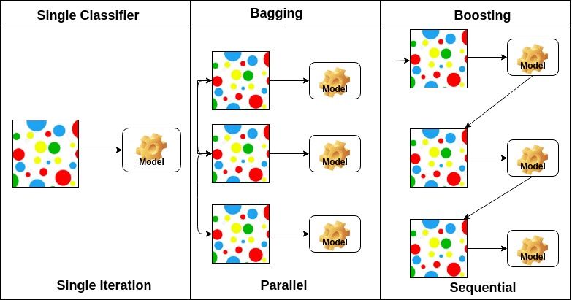

Slide 14
ADVANTAGES of EL
Improved Accuracy: Ensembles often outperform individual models, especially when the base models are diverse and bring different perspectives to the problem.
Increased Robustness: Ensembles are less susceptible to overfitting, as the errors of individual models are often mitigated by the ensemble s collective decision-making process.
Enhanced Generalization: Ensembles can generalize well to new, unseen data, making them useful in a variety of machine learning tasks.
Model Stability: Ensembles are less sensitive to noise and outliers in the data.

Slide 15
RANDOM FOREST
Random Forest is an ensemble learning method that belongs to the broader class of decision tree-based models. It is used for both classification and regression tasks. Random Forest builds multiple decision trees during training and merges them together to get a more accurate and stable prediction.
Imagine you re trying to make a decision, like whether to go outside based on the weather. Instead of relying on just one friend s opinion, you decide to ask several friends because they might have different perspectives. Each friend might consider different things like temperature, clouds, or wind.

Slide 16
CHARACTERISTICS OF RF
Ensemble of Decision Trees: Random Forest builds a "forest" of decision trees. Each tree is trained independently on a random subset of the training data.
Instead of having one decision maker (like one friend), you have a group of decision makers (a forest of trees).
Random Subsampling of Data: At each tree s training phase, a random subset of the training data (with replacement) is used. This is known as bootstrap sampling or bagging (Bootstrap Aggregating).
- Each decision maker (tree) looks at a random set of information (data) to form their opinion. They don’t all see the same things.
3. Random Feature Selection: When splitting nodes in each decision tree, a random subset of features is considered. This introduces additional randomness and diversity among the trees.
- When each decision maker is thinking about the decision, they only focus on a few factors, not everything. This adds more diversity to their opinions.

Slide 17
4. Voting (Classification) or Averaging (Regression): For classification tasks, the final prediction is typically determined by a majority vote among the individual trees. For regression tasks, it s the average prediction of all trees.
- After you ve asked all your friends (trees), they vote on whether you should go outside or not (for classification problems). Or they might give you an average response (for regression problems).
5. Reduces Overfitting: The randomness introduced in both data and feature selection helps reduce overfitting, making the model more robust and better at generalizing to unseen data.
- If one friend is a bit biased or too focused on certain details, it s okay because the group decision helps balance things out. This prevents relying too much on one person s quirks.
6. Parallel Training: Each tree in the Random Forest can be trained independently, allowing for parallelization and faster training on multi-core processors.
- You can ask your friends simultaneously. They don t need to wait for each other to give their opinions.

Slide 18
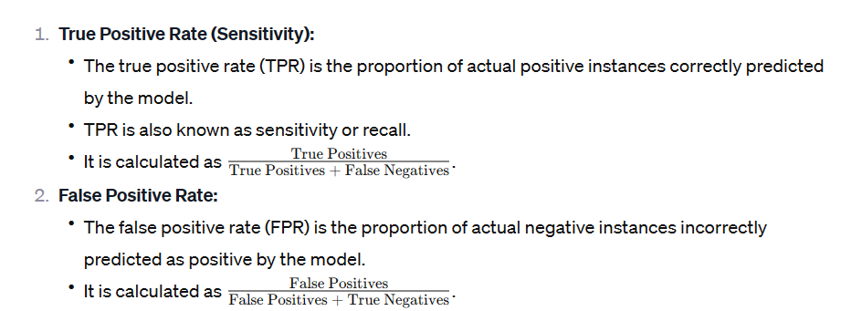
ROC - AUC
The Receiver Operating Characteristic (ROC) curve is a graphical representation of a binary classification model s performance at various classification thresholds. It illustrates the trade-off between the true positive rate (sensitivity) and the false positive rate (1 - specificity) as the decision threshold for classifying positive instances is varied.

Slide 19
3. Threshold Variation:
The ROC curve is created by varying the classification threshold of the model and observing how TPR and FPR change. The threshold determines the point at which the model classifies an instance as positive or negative based on the predicted probability.
4. Area Under the Curve (AUC):
The AUC represents the area under the ROC curve and quantifies the overall performance of the classification model.
A higher AUC indicates better discriminative ability.

Slide 20
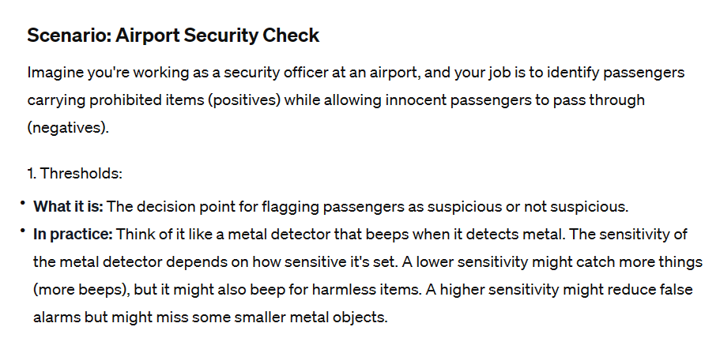

Slide 21
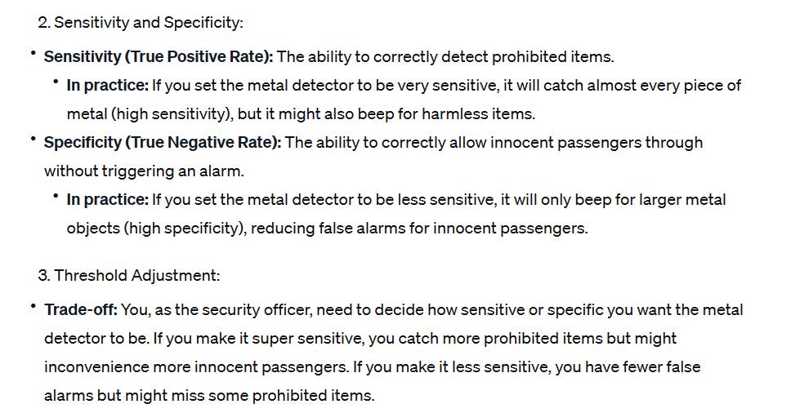

Slide 22
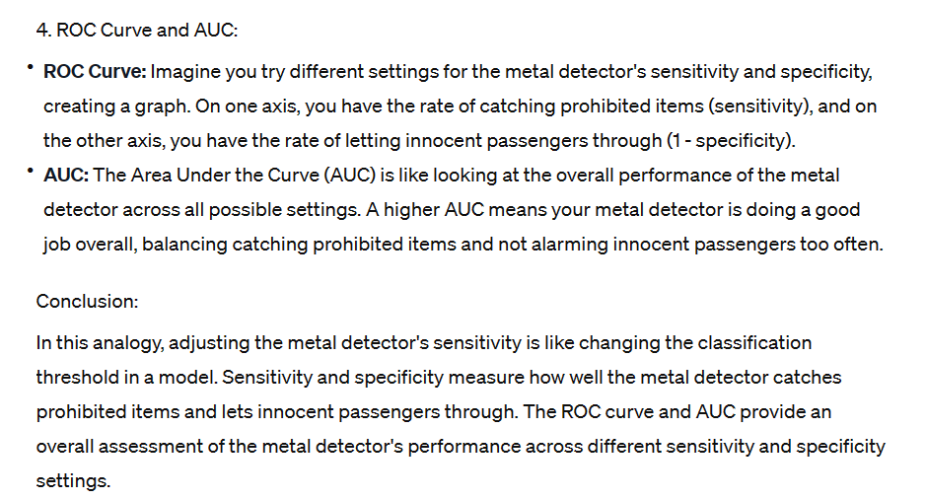

Slide 23
ADABOOST
AdaBoost, short for Adaptive Boosting, is an ensemble learning technique that is primarily used for classification problems. It belongs to the family of boosting algorithms, which work by combining the predictions of multiple weak learners to create a strong classifier.

Slide 24
HOW ADABOOST WORK?
1. Weak Learners: AdaBoost starts with a weak learner, which is a simple model that may perform slightly better than random chance. It could be as simple as a decision tree with a small depth (called a "stump").
2. Weighted Data: In the first iteration, each data point is given equal weight. The weak learner is trained on this data, and it makes predictions.
3. Adjusting Weights: AdaBoost then adjusts the weights of misclassified data points. It increases the weights of the misclassified points so that the next weak learner focuses more on getting those points right.
4. Multiple Iterations: This process is repeated for several iterations. In each iteration, a new weak learner is trained on the data, and the weights of misclassified points are adjusted.
5. Combining Predictions: The final prediction is a weighted sum of the predictions from all weak learners. The weights are based on the accuracy of each weak learner, with more accurate learners having a higher influence on the final prediction.
The key idea behind AdaBoost is that it focuses on the mistakes made by the previous models, allowing the ensemble to progressively improve its performance. Weak learners that perform well on difficult-to-classify instances get more attention in subsequent iterations.

Slide 25
GRADIENT BOOSTING
Gradient Boosting is another ensemble learning technique, like AdaBoost, but it uses a different strategy to build a strong predictive model. Gradient Boosting builds an ensemble of decision trees sequentially, where each tree corrects the errors of the previous one. This approach often results in highly accurate models.

Slide 26
HOW GB WORKS?
1. Initialize Model: It starts with a simple model, often a shallow decision tree (weak learner), as the first estimator.
2. Predictions: The initial model makes predictions on the training data. These predictions are likely to have errors.
3. Calculate Residuals: The differences between the actual values and the predictions are calculated. These differences are called residuals.
4. Train a New Model: A new decision tree is then trained to predict the residuals. This tree focuses on correcting the errors made by the previous model.
5. Update Predictions: The predictions from the new tree are added to the previous predictions. The combined predictions are expected to be more accurate than those of the initial model.
6. Repeat: Steps 3-5 are repeated for a specified number of iterations or until a certain level of accuracy is achieved.
7. Final Prediction: The final prediction is the sum of predictions from all the trees.
The key idea is that each new tree in the ensemble corrects the mistakes of the combined ensemble so far. This process is done in a way that minimizes a loss function, such as mean squared error for regression or cross-entropy loss for classification.

Slide 27
LOGISTIC REGRESSION
Regression is a statistical method used in machine learning and statistics to examine the relationship between a dependent variable and one or more independent variables. The goal of regression analysis is to model and understand the relationship between variables, predict the value of the dependent variable based on the values of independent variables, and identify the strength and nature of these relationships.
In simple terms, regression helps us understand how changes in one or more independent variables are associated with changes in a dependent variable. The result of a regression analysis is a regression equation or model that can be used for making predictions.

Slide 28
There are different types of regression models-
1. Linear Regression: Assumes a linear relationship between the dependent variable and the independent variables. The model is represented by a straight line.
2. Multiple Regression: Extends linear regression to multiple independent variables, allowing for the analysis of the impact of each variable while controlling for others.
3. Polynomial Regression: Allows for non-linear relationships by including polynomial terms (e.g., quadratic or cubic terms) in the model.
4. Logistic Regression: Used when the dependent variable is binary or categorical, predicting the probability of an event occurring.
Regression analysis involves estimating the coefficients of the model, which represent the relationship between the variables. The process often includes assessing the goodness of fit, checking assumptions, and interpreting the results to draw meaningful conclusions about the relationships within the data. Regression is widely used in various fields, including economics, biology, psychology, and machine learning, among others

Slide 29
VOTING CLASSIFIER
A Voting Classifier is an ensemble machine learning model that combines the predictions from multiple individual models (classifiers) to make a final prediction. The idea is to let different models "vote" on the predicted class, and the class with the most votes becomes the final prediction. This can often result in improved overall performance compared to individual models.
There are two main types of voting in a Voting Classifier:
1. Hard Voting: In hard voting, each individual classifier in the ensemble "votes" for a class, and the majority class is chosen as the final prediction. This is effective when the individual classifiers have diverse perspectives.
2. Soft Voting: In soft voting, each classifier provides a probability score for each class, and the final prediction is based on the average probabilities. This is useful when classifiers can output probabilities, as it takes into account the confidence of each classifier in its prediction.

Slide 30
Imagine you re making a decision, like predicting if a person will buy a product. Instead of relying on just one persons opinion, you ask several friends who have different perspectives. Each friend has their own way of deciding, and they might make mistakes sometimes. But if most of them agree on a decision, you re likely to make a better choice.
A Voting Classifier in machine learning is like having these friends. Instead of using only one model to make predictions, you use several different models (friends) together. Each model gives its opinion on what the outcome should be, and the final decision is made based on the majority vote. This way, even if one model makes a mistake, the others can compensate for it.
So, it s like combining the strengths of multiple models to make better predictions than each model could do alone.

Slide 31
Hard Voting:
- Imagine you have a group of friends trying to decide whether to watch a comedy or a drama movie.
- Each friend independently votes for their preference without considering how confident they are.
- The final decision is based on the majority vote. If more friends prefer comedy, you ll watch a comedy; if more prefer drama, you ll watch a drama.
- It s a straightforward "majority wins" approach without considering how strongly each friend feels about their choice.
Soft Voting:
- Now, your friends not only vote but also provide a confidence level for their choice. For example, one friend might say, "I m 80% sure we should watch a comedy."
- Each friend s opinion is weighted based on their confidence level.
- The final decision is made by combining the weighted votes. If the total confidence for comedy is higher, you ll watch a comedy; if it s higher for drama, you ll watch a drama.
- It s a more nuanced approach that considers not only the majority but also the confidence of each friend in their decision.
In summary, hard voting is a simple "majority rules" decision-making process, while soft voting takes into account the confidence or probability assigned by each voter, making the decision more nuanced and potentially accurate.

Slide 32
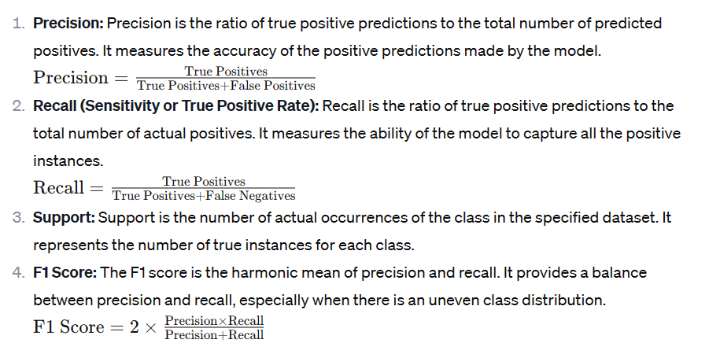
Macro Avg: This is the average of precision, recall, and F1 score across all classes.
Weighted Avg: This is the weighted average of precision, recall, and F1 score, where each class's score is weighted by its support (the number of true instances).

